Slide 1
Why Tiny Tina’s Wonderlands is addictive.

Slide 2
The key factors that make it addictive
Self-increasement
Repetition

Slide 3
The Pleasure of Self-increasement
the principle of self-increasement:
Mindless self-increasement is a essential core of capitalism, the capitalism system self-increase itself by mediated spirits.
This system breaks the spirits into two parts, that are sadists and masochists.

Slide 4
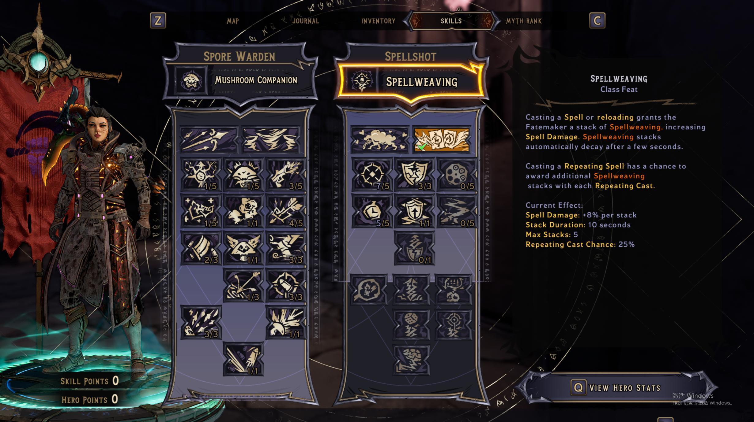
The Pleasure of Self-increasement
Level system:
The level system is a ideal capitalism system because of it certainty, every action is rewarded. Every monster is killed, every quest is completed generates experience points. After getting enough exp, a skill point is rewarded, one can buy new skill with the skill point, with a higher level, High level items can drop from battlefield.

Slide 5

The Pleasure of Self-increasement
The opposite case：education
Students are teached to achieve higher grades(marks) in China.
But marks is a relative, dynamic value which depend on competition between students.
That is to say, the bulk of students are frustrated in this system.
Only minority is rewarded.

Slide 6
Do you think students who obsess with video games are lazy?

Slide 7
The Pleasure of Self-increasement
they obsess with video games precisely because they are too diligent.
they are too eager to get good marks.
they indeed get good marks in game systems.
NO

Slide 8
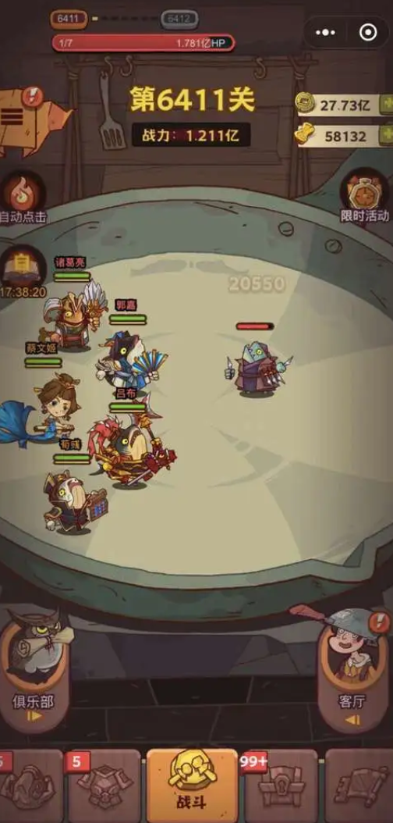
The Pleasure of Self-increasement
Another example:King of Salted Fish(咸鱼之王)
"King of Salted Fish" is an automatic placement mobile game.
It is a completely automatic self-increasement system which you can spend money to quicken the self-increasement.

Slide 9
The Pleasure of Self-increasement
the principle of Repetition:
Repetition is the nature of human being.
It is the death driving force from the abyss.

Slide 10
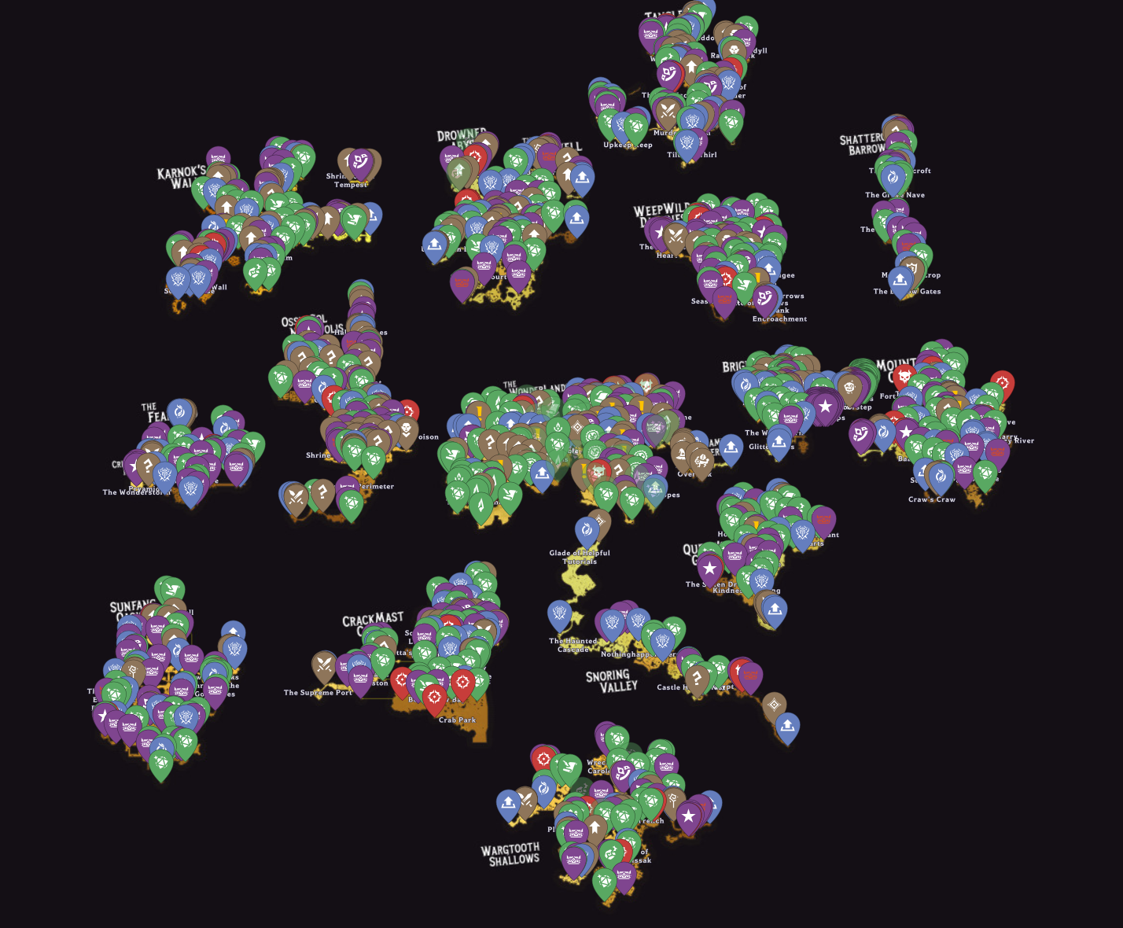
The Pleasure of Self-increasement
Massive repeated elements：
Every map in tiny tina is full of massive elements, such as collectibles, side quest.
When repeated in the elements, one can hear the voice from the abyss - don’t stop till dead.

Slide 11

The Pleasure of Repetition
Another example:TikTok
TikTok, a short-form videos platform that is full of sexy women dancing, nonsensical plots, vulgar dogmatic opinions.
Hundreds of millions of population are addicted to it.
The voice from abyss is loud here.

Slide 12
My father always says to me it is meaningless to play video games, no matter how many levels you beat, what do you think about it.

Slide 13
The Pleasure of Repetition
His point is wrong precisely because it is too right.
By saying this is precisely to avoid the problem itself.
It is meaningful because it is meaningless, in other words, meaningless is its meaning. (meaning-less).

Slide 14
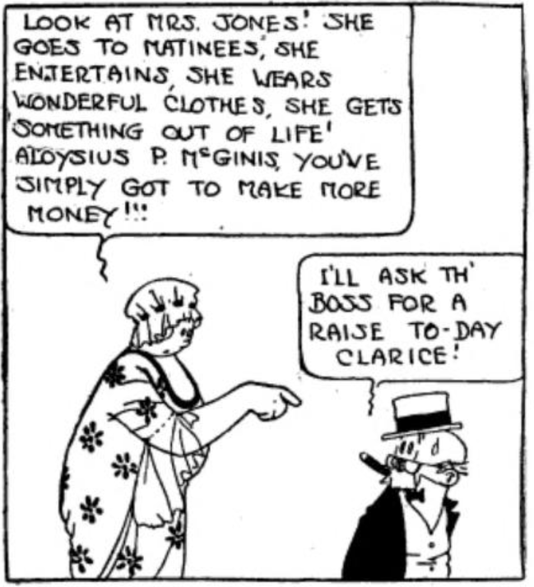
Comparison
The key to the success of China's video game market is Comparison.
In other word, to Keep up with joneses.
Essential core of China community

Slide 15

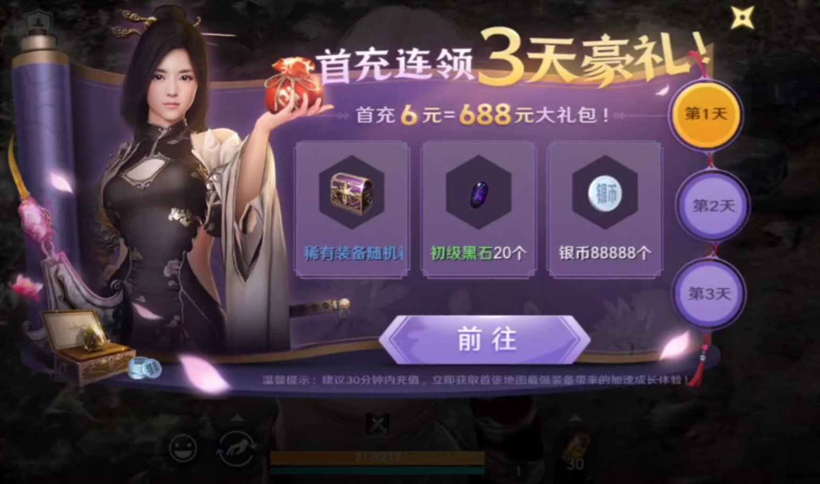
The Pleasure of Repetition
Another example:Regulation of online games
In order to maintain MAU, online games force player to complete daily quests and daily login.
In order to put players gaurd down, online games offer recharge bonus.
By repeating players, they are regulated.

Slide 16
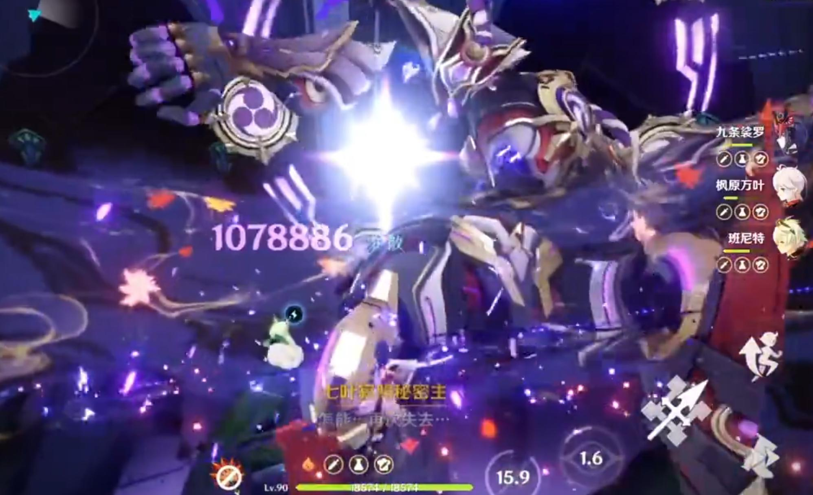
Comparison
Using a cheater to instant kill in a solo game is boring.
Type | Instant Kill
Single | boring
Multiple | exciting
Spending dozens of thousands of dollars to instant kill in online games is exciting.
When performing an instant kill, one needs to imagine the struggle of other players with monsters, it brings one climax.

Slide 17
What do you think of the monetization system in mobile games nowadays?

Slide 18
What do you think of comparison. Do you like to compare yourself to others?

